Slide 1
General Chemistry
Course: CHE 101
Dr. Md. Aslam Hossain
Professor
Dept. of Pharmaceutical Chemistry
Faculty of Pharmacy
University of Dhaka

Slide 2
Basic knowledge of Chemistry:
Introduction to atomic structure, quantum mechanical atom, quantum numbers, electronic configuration, chemical bonding and valence shell electron pair repulsion theory for predicting molecular geometry.
The theory of chemical bond formation, periodic table and period classification of elements with their properties, transition elements and coordination chemistry, types of chemical reactions, oxidation-reduction reactions, acids and bases, inert gases, application of valence bond theory to coordination compounds;
Chemistry of solids and crystals; States of matter; chemical equilibrium, environmental chemistry.
Recommended Books:
1. Introduction to modern inorganic chemistry S.Z. Haider
2. Modem inorganic chemistry R.D. Madan
3. Essentials of physical chemistry B. S. Bahl, G.D Tuli

Slide 3
Structure of Atom

Slide 4
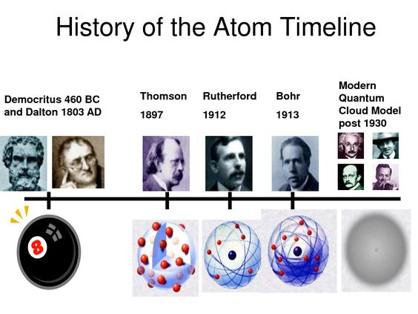
Structure of Atom

Slide 5
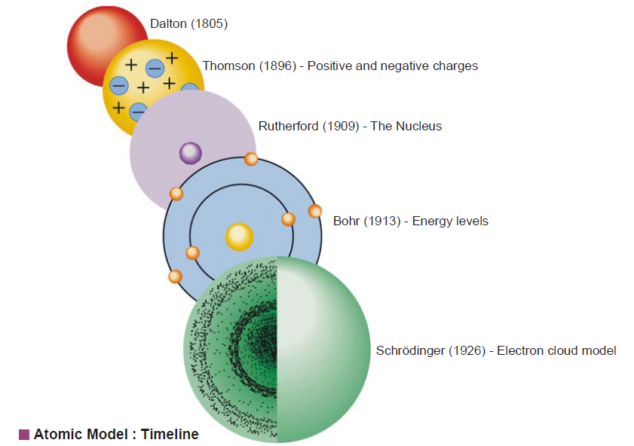

Slide 6
Dalton’s Atomic Theory
It was in 1803 that John Dalton, an English Chemist, came up with his atomic theory. The postulates of this theory can be stated as follows:
All Elements consist of tiny particles called atoms.
All atoms of an element are identical and they have the same mass.
Atoms are indivisible and unchanging. (Greek: atom = cannot be cut, i.e. indivisible).
Atoms of each element are different from one another and they have different masses.
Compounds consist of atoms of different elements combined together and they have constant composition because they contain constituent atoms in a fixed ratio.
Chemical reactions involve the rearrangement of combinations of constituent atoms of compounds.

Slide 7
Limitation of Dalton’s Atomic Theory
Dalton’s theory states that atoms are indivisible, but the subsequent works of various scientists proved that atoms consist of various subatomic particles, mainly electron, proton and neutron.
Dalton’s theory states that atoms are unchanging, but subsequent experiments of scientists proved that one atom can be converted to another atom.

Slide 8
Structure of Atom
Definition of atom:
Atom is the smallest component of an element having the chemical properties of that element, consisting of a nucleus containing combinations of neutrons and protons and one or more electrons rotating around the nucleus by electrical attraction.
The number of protons determines the identity of the element.
These particles are regarded as fundamental particles, because these are the main constituents of atoms.

Slide 9
An atom is the smallest constituent unit of ordinary matter that has the properties of a certain chemical element.
Every solid, liquid, gas and plasma is composed of neutral or ionized atoms.
Atoms are very small; typical sizes are around 100 pm (a ten-billionth of a meter, in the short scale).
However, atoms do not have well-defined boundaries, and there are different ways to define their size that give different but close values.

Slide 10
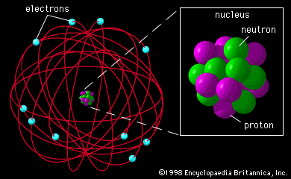
Subatomic Particles
Atoms are composed of a nucleus surrounded by electrons.
The nucleus contains:
Neutron
Proton

Slide 11
Subatomic Particles
Neutron
Discovered by Chadwick in 1932.
Charge: Neutral
Mass: 1.675x10⁻²⁴ gm
~ 1 amu (Atomic mass unit)
Proton
Predicted in 1911 by Rutherford by scattering of α- rays.
Charge: Positive (+1 )
Mass: 1.672x10⁻²⁴ gm
~ 1 amu (Atomic mass unit)

Slide 12
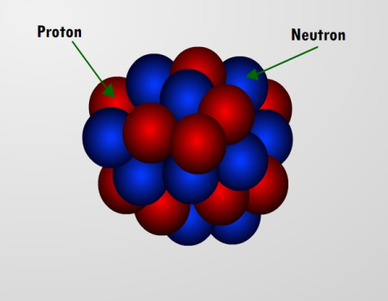
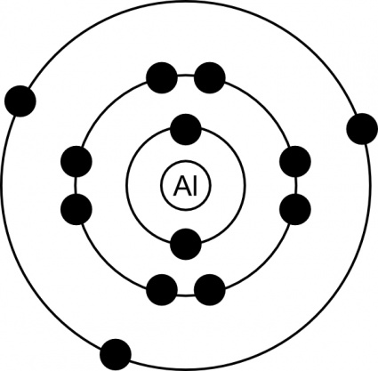
Electron
Predicted by scattering of β- rays. In 1897 J.J. Thomson discovered the electron
Charge: Negative (-1 )
Mass : 9.107x10⁻²⁸ gm
~ 0 amu (Atomic mass unit)

Slide 13
Atomic number: Atomic number of an element can be defined as the number of positive charges or protons in the nucleus of its atom. "The number of electrons outside the nucleus in a neutral atom also gives its atomic number.
Atomic weight: The atomic weight of an element is approximately equal to the sum of the weights of the total number of protons and the total number of neutrons in the nucleus.
Avogadro number: The actual number of molecules in a gram molecule or the number of atoms in, a gram atom of any substance is called Avogadro number. This number is denoted by N and has a value 6.023x10²³ molecules per mole (or atoms per gram atom).

Slide 14
Rutherford's α-particle bombardment experiment
A stream of alpha particles (He⁺⁺) was directed at a thin foil of gold and a detector arranged to surround the sample completely except for a small hole for entry of the particles. The foil was several thousands of atoms thick.
Expected Outcome: Keeping the prevailing model in mind (Thomson's 'raisin pudding') the cloud of positive electricity should offer little resistance to the passage of an alpha particle even though the latter is charged.
The reasoning is that alpha particles are moving at high speed and have a great amount of forward momentum (mass x velocity = momentum). Even though there would be some repulsion due to like charges, the momentum would overcome this and the particles ought to be deflected slightly or go straight through.

Slide 15
Results:
Most of the alpha particles pass straight through the gold foil without any deflection from their original path.
A few alpha particles are deflected through small angles and few are deflected through large angles.
A very few alpha particles completely rebound on hitting the gold foil and turn back in their path (just as a ball rebounds on hitting a hard wall).

Slide 16
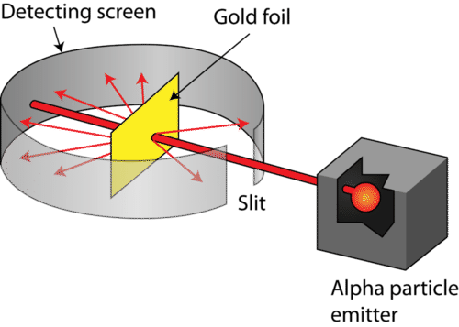
Fig.: Rutherford's α-particle bombardment experiment

Slide 17
Explanation:
Since most of the alpha particles pass straight through the gold foil without any deflection it shows there is a lot of empty space in an atom.
Some of the alpha particles are deflected through small and large angles, which shows that there is a 'center of positive charge in an atom, which repels the positively charged alpha particles and deflects them from the original path.
Very few alpha particles rebound on hitting the gold foil, which shows the nucleus is very dense and hard which does not allow alpha particles to pass through it. The whole mass of the atom is centered at its nucleus.

Slide 18
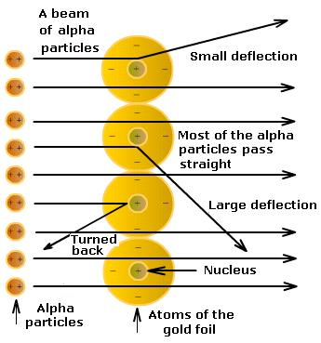
Fig.: Explanation of Rutherford's α-particle bombardment experiment

Slide 19
Rutherford's atom model
The atom model that Rutherford proposed very much similar to our solar system. For this reason, it is called Rutherford's solar system atom model.
The major propositions of the model are:
1. An atom consists of a small nucleus containing all the positive charges of the atom and practically the whole of its mass.
2. The nucleus is surrounded by a number of electrons equal to the number of positive charge on the nucleus.

Slide 20
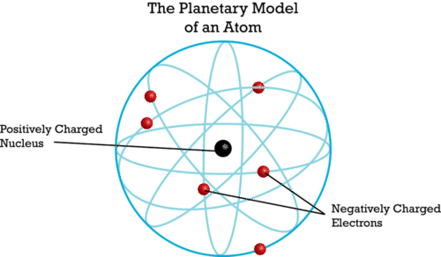
3. The electrons move in orbits or closed paths around the nucleus like planets move around the sun.
4. The electrostatic force of attraction between the electrons and positive nucleus is counterbalanced by the outward centrifugal force produced by the motion of electrons.

Slide 21
Limitations of Rutherford's atom model
Rutherford's atom model is based upon Newton's Laws of motion and gravitation. Scientist Bohr pointed out some limitations of Rutherford's atom model which are as follows:
Newton's Laws of motion and gravitation can only be applied to neutral bodies such as planets and not to charged bodies such as tiny electrons moving round a positive nucleus.
The analogy does not hold good since the electrons in an atom repel one another, whereas planets attract each other because of gravitational forces.

Slide 22
According to Maxwell's theory, any charged body such as electrons rotating in an orbit must radiate energy continuously. If an electron radiates energy, its speed will decrease and it must gradually spiral in towards the nucleus. The radius of the electron will gradually decrease and it will ultimately fall into the nucleus, thus annihilating the atom model. This does not happen actually.
Rutherford did not give any idea about shape or size of the pattern in which the electrons move around the nucleus.

Slide 23
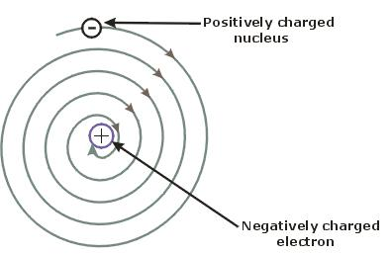
Negatively charged electron
Positively charged electron
Fig. An electron revolving round the nucleus in orbit continuously emits radiations and loses energy, and ultimately falls into the nucleus.

Slide 24
Bohr’s Atom Model
In 1913 Neils Bohr proposed a workable model of the atom. The theory consists of the following postulates:
1. Postulate of Energy level
a) An atom has a number of stable orbits in which an electron can rotate without the radiation of energy. These orbits are referred to as “Energy Levels”.
b) If an electron moves in a circular orbit, its motion is subject to the ordinary laws of electrical and centrifugal forces. Here the angular momentum of the electron (mvr) must be multiple of h/2π, that is:
mvr = n.h/2π
where m is the mass of the electron, v is the velocity, r is the radius of the orbit and n is 1, 2, 3, 4, 5 etc. (h is the plank’s constant)

Slide 25
02. Postulate of Frequency or Radiation
According to this postulate an electron can jump from one orbital to another. An atom radiates energy as light when an electron passes from a higher energy level to another lower energy level. The atom then gives definite spectral lines in emission spectra.
On the other hand, the jump of an electron from a lower energy level to a higher energy level is evident by absorption of energy giving dark lines. The quantity of energy radiated or absorbed is equal to the difference between the energies the atom possessed before and after the electron changed orbits.

Slide 26
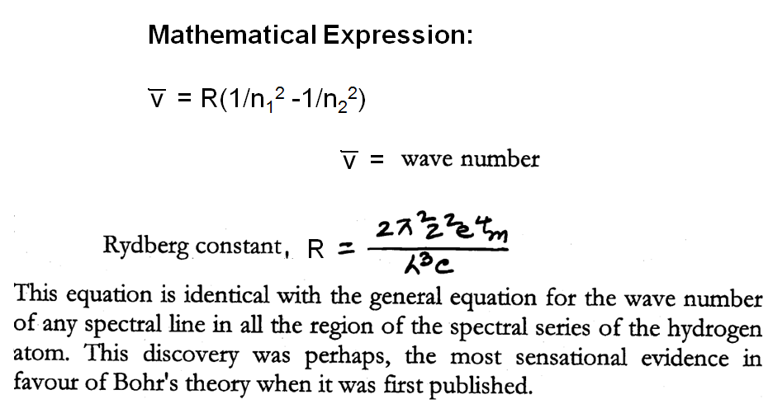
Bohr’s Atom Model

Slide 27
Limitations of Bohr’s Atom Model
Bohrs Theory was highly successful in explaining the spectrum of hydrogen but failed to predict the energy states of more complicated atoms in which there are more than one electron.
No explanation of fine structure: Bohr’s theory had successfully explained the origin of hydrogen spectrum. But when the hydrogen spectrum is observed by means of spectroscope of high resolving power, it is found that individual spectral lines are not really single but consist of several very fine lines lying close together. This fine structure of spectral lines in the hydrogen spectrum cannot be explained by Bohr’s theory.

Slide 28
According to Bohr’s model electrons revolve in, circular orbits but modern research reveals that electrons may revolve in elliptical orbits also.
Moreover, according to Heisenberg’s Uncertainty Principle, both the position and the momentum of an electron in an atom cannot be fixed simultaneously.

Slide 29
Quantum number
The numbers, which express the size, shapes, direction of the orbital from the nucleus and the spins of the electron of their own axis are called quantum numbers.
There are four types of quantum numbers:
I. Principal quantum number
2. Subsidiary quantum number
3. Magnetic quantum number
4. Spin quantum number

Slide 30
1. Principal quantum number:
This expresses the orbits or principal energy levels to which the electron belongs. It is denoted by n (n= 1, 2, 3 etc.). For the first orbit, n=1, for the second orbit. n=2 and so on.
The energy levels are also called electron shells. Inner most shell is known as K shell and the succeeding outer shells are denoted by the letter L, M, N, O, P, Q etc.
Principal quantum number represents any particular circular orbit. the value of n gives roughly the binding force and the distance between the nucleus and the electron. The first energy level is the one nearest the nucleus.
This quantum number also represents the size of the electron orbit.

Slide 31
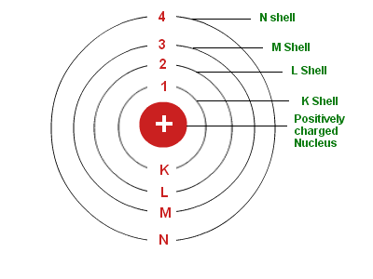

Slide 32
2. Subsidiary quantum number
The main energy levels (or shells) of electron may be considered as being made up of one or more sub-levels (sub-shells). The number, which is used to express the sub-level in which the electron belongs, is designated as subsidiary quantum number or Azimuthal quantum number. It is denoted by l.
The value of l depends on the value of n (principal quantum number). For a given value of n, l can have all values from 0 to n-1 each of which refers to an energy sublevel or sub-shell.
The values of l i.e. the subsidiary quantum number 0, 1, 2, 3 are also symbolized by letters s, p, d, and f respectively. Subsidiary quantum numbers describes the shapes of the electron orbit / energy level.

Slide 33
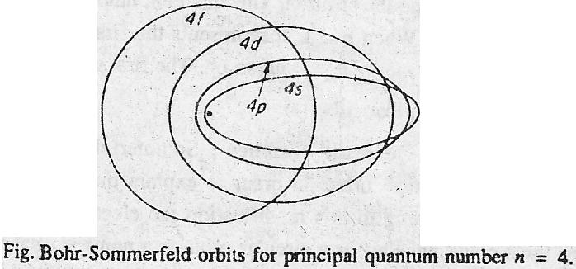
The orbits are circular when l = n-1 and have elliptical shapes when l is different from n-1. Fig. shows the orbits with n=4.
Fig. Orbits for principal quantum number n=4

Slide 34
3. Magnetic quantum number/orientation quantum number:
The magnetic quantum number was introduced to explain the orientation of electronic orbit in space particularly under the influence of an applied magnetic field.
This is designated by m.
The permitted values of m are dependent upon l. m can have values from -l to +l including 0 i.e. there are (2l+1 ) values.

Slide 35
For l = 0 (s orbital), the magnetic quantum number m will have 1 value. So there will be only one orientation for s orbital.
For l = 1 (p orbital), the magnetic quantum number m will have three values: +1, 0 and -1. So there are three orientations for p orbital. These three types of p orbital differ only in the value of magnetic quantum number and are designated as p_{x}, p_{y}, p_{z}, depending upon the axis of orientation. The subscripts x, y and z refer to the co-ordinate axis.

Slide 36
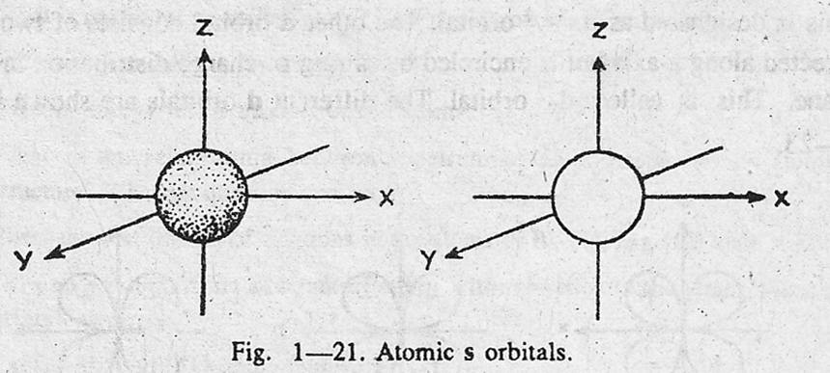
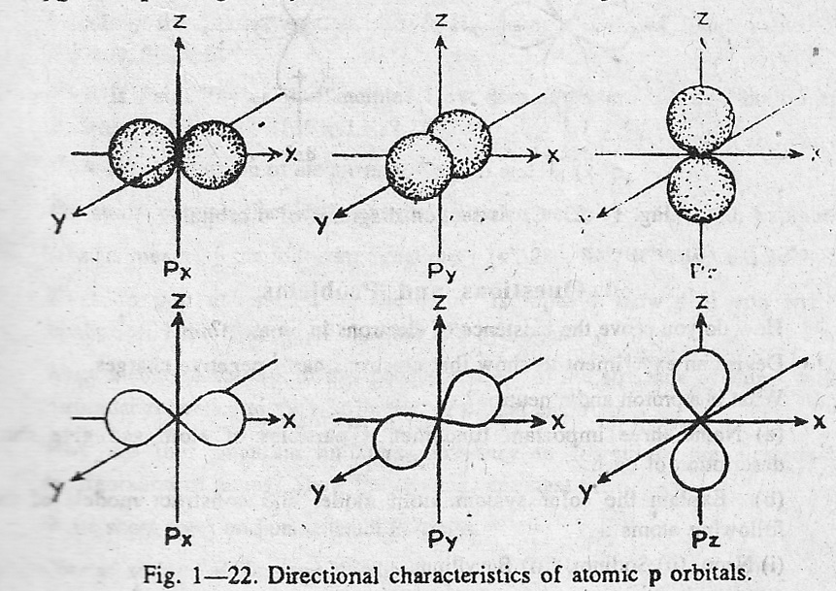

Slide 37
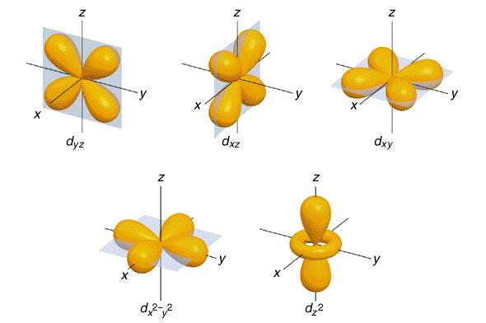
d orbitals

Slide 38
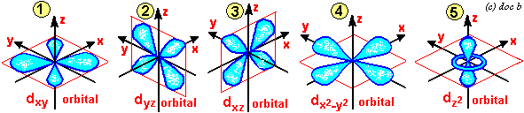
d orbitals

Slide 39
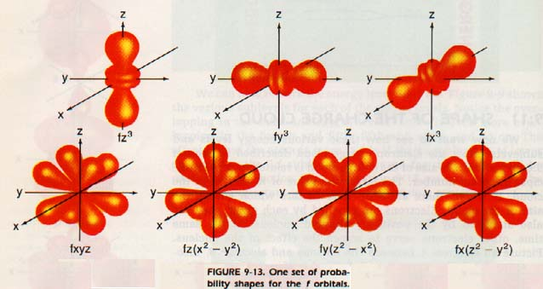
f orbitals

Slide 40
4. Spin quantum number
The spin quantum number represents the direction of the electron spin and is designated by s.
The direction of spin is investigated in presence of external magnetic field and it was found that all electrons spin either in one direction (say, and clockwise direction) or in the direction directly opposite (anti-clockwise).
Their values are, s = +1/2 and s = -1/2. They are often represented by putting two arrows in the opposite directions: ↑ and ↓.

Slide 41
Quantum numbers and orbitals of different sub-levels
Principal Quantum number (n) | Subsidiary quantum number (l) l = 0 to n-1 | sub-levels | Magnetic quantum number (m) m = +l to –l including 0 | orbital number
1(K) | 0 | 1s | 0 | 1
2(L) | 0 1 | 2s 2p | 0 +1, 0, -1 | 1 3

Slide 42
Principal Quantum number (n) | Subsidiary quantum number (l) l = 0 to n-1 | sub-levels | Magnetic quantum number (m) m = +l to -l including 0 | orbital number
3(M) | 0 1 2 | 3s 3p 3d | 0 +1, 0, -1 +2, +1, 0, -1, -2 | 1 3 5
4(N) | 0 1 2 3 | 4s 4p 4d 4f | 0 +1, 0, -1 +2, +1, 0, -1, -2 +3, +2, +1, 0, -1, -2, -3 | 1 3 5 7

Slide 43
Pauli's Exclusion Principle
Pauli’s exclusion principle states that, no two electrons in the same atom can have the same values for all four quantum numbers. The above rule appears to be analogous to the law:
“Two bodies cannot be placed in the same position at the same time”. Thus, two electrons of the same atom can have the same values for three of their quantum numbers, but the fourth quantum number must be different for the two electrons.
Thus two electrons may have orbits of the same size' shape and orientation in space provided they have opposed spins.

Slide 44
EXAMPLE : We know that 1s orbital contains two electrons. Their set of quantum numbers is:
electron | n | l | m | s
e₁ | 1 | 0 | 0 | +1/2
e₂ | 1 | 0 | 0 | -1/2
The fourth quantum number i.e. spin quantum number is different for both electrons.
Let us suppose that 1s-orbital contains three electrons i.e. 1s³, in this situation:
electron | n | l | m | s
e₁ | 1 | 0 | 0 | +1/2
e₂ | 1 | 0 | 0 | -1/2
e₃ | 1 | 0 | 0 | ???

Slide 45
Since there are only two possible values of spin quantum number, therefore, third electron can not be accommodated in 1s-orbital. This clearly points out that an orbital can not contain more than two electrons. Hence according to Pauli exclusion principle, 1s² is correct but 1s³ is not possible.

Slide 46
Aufbau's law: Electrons go to the different orbital according to their increasing energy. Electrons first go to the-orbital of low energy and then systematically to the orbital of higher energy. It is known as Aufbau’s laws. The orbital which has lower value of (n+l) has the lower energy and higher value of (n+l) has higher energy.
Here, n = Principal energy level
l = subsidiary energy level
Example: Considering 4s and 3d orbital:
For the 4s orbital, the value of, n = 4 and the value of l = 0 (s). The total value of (n+l) = 4+0 = 4
Again for the 3d orbital, the value of, n = 3 and the value of l =2 (d). The total Value of (n+l) = 3+2 =5
So, electrons will go to 4s orbital first then to 3d orbital.

Slide 47
Considering 3d and 4p orbital:
For the 3d orbital, the value of, n = 3 and the value of l = 2 (d). The total value of (n+l) = 3+2 = 5
For the 4p orbital, the value of, n = 4 and the value of l = 1 (p). The total value of (n+l) = 4+1 = 5
If the two orbital have the same value of (n+l) then electrons will go to that orbital first, which has lower principal quantum number. So electrons will go to the 3d first.

Slide 48
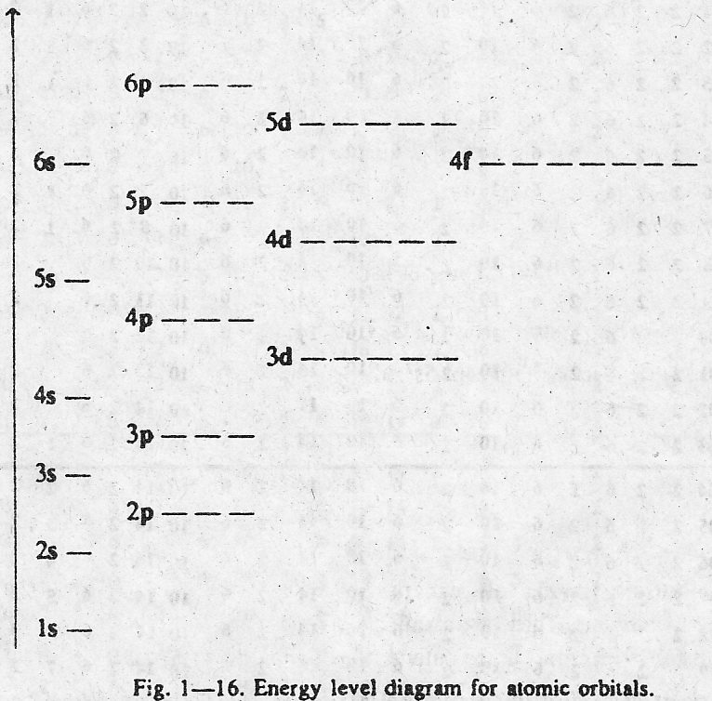
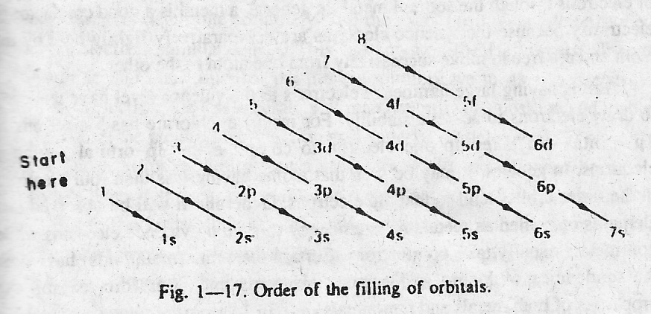

Slide 49
Hund’s Rule
In the ground state of any atom, an electron may enter only the vacant orbital of lowest energy.
In other words, lower energy orbitals must be filled before higher energy orbitals.
Electrons must enter degenerate orbitals, that is orbitals having the same energy, i.e., 2Px, 2Py, 2Pz, singly and with parallel spins.
In other words, electrons should remain unpaired in degenerate orbitals as long as possible.

Slide 50
Distribution of electrons in the atoms of electrons:
The electrons are arranged among the known elements in seven main energy levels designated by the principal quantum numbers n = 1, 2, 3, 4, 5, 6, 7. These principal energy levels are divided into sub-levels indicated by s, p, d, and f.
The first energy level (n=1) which has only one sub-level is designated as 1s. The second energy level (n = 2) has two sub-levels designated as 2s and 2p, the third (n=3) energy level has three sub-levels designated as 3s, 3p and 3d and the fourth energy level n=4 has four sub-levels 4s, 4p, 4d and 4f.

Slide 51
The sub-levels are further divisible into orbitals. An s sub-level is made up of one orbital; a p sub-level three orbitals; a d sub-level five orbitals and f sub-level seven orbitals.
Each electron orbital can accommodate a maximum of two electrons of opposed spins. Thus 1s orbital can hold a maximum of two electrons. The three p orbitals can hold a maximum of 6 electrons etc.
Thus we get each electron shell can hold a maximum of 2n² electrons where n is the shell number.

